Slide 1
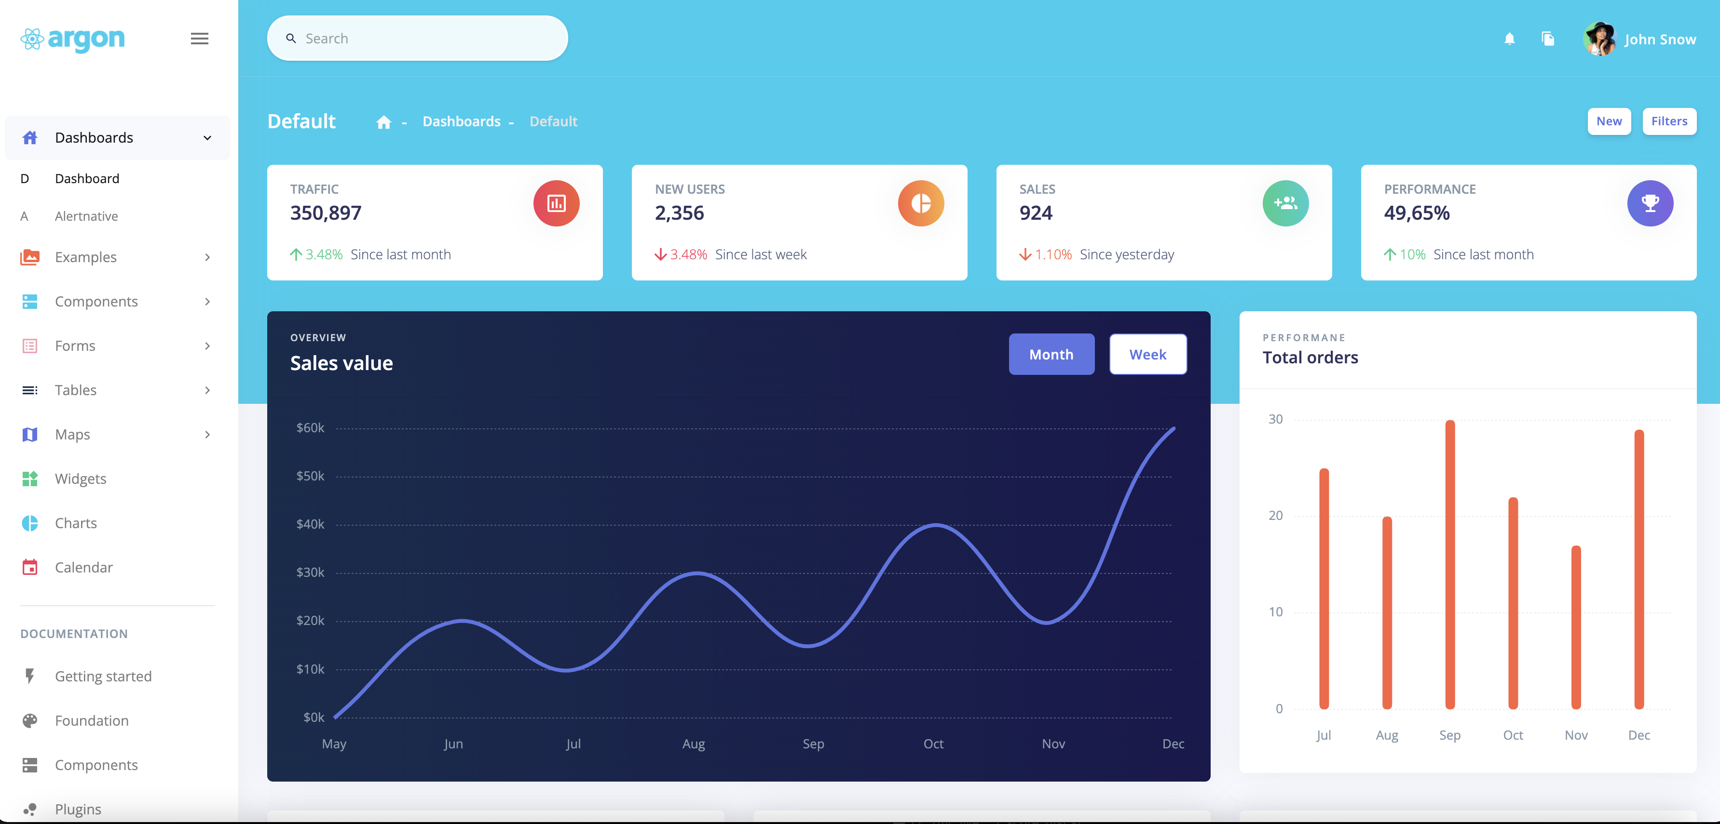

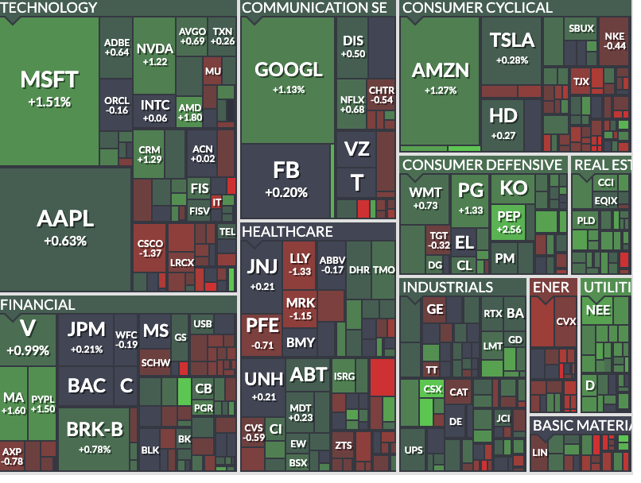
Homepage
Asset
S&P
DOW
Nasdaq
Russell
Ticker search
Default index
Daily
Industry daily performance

Slide 2
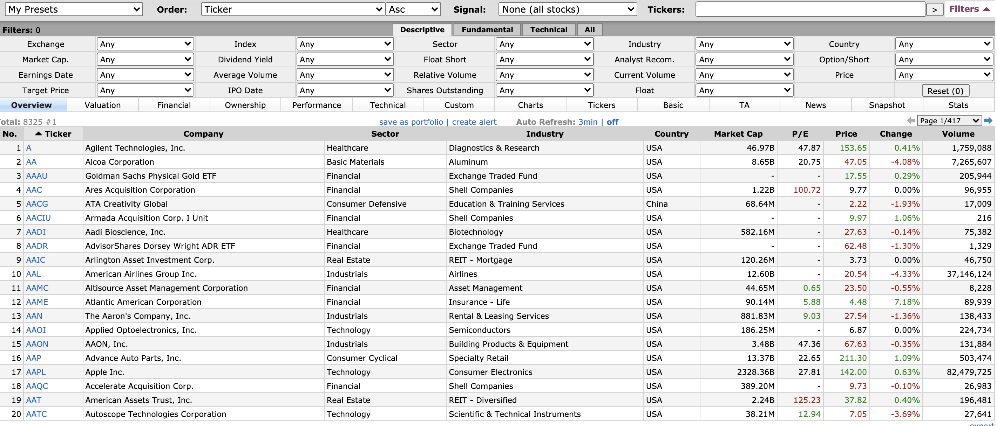
Stock Screener

Slide 3

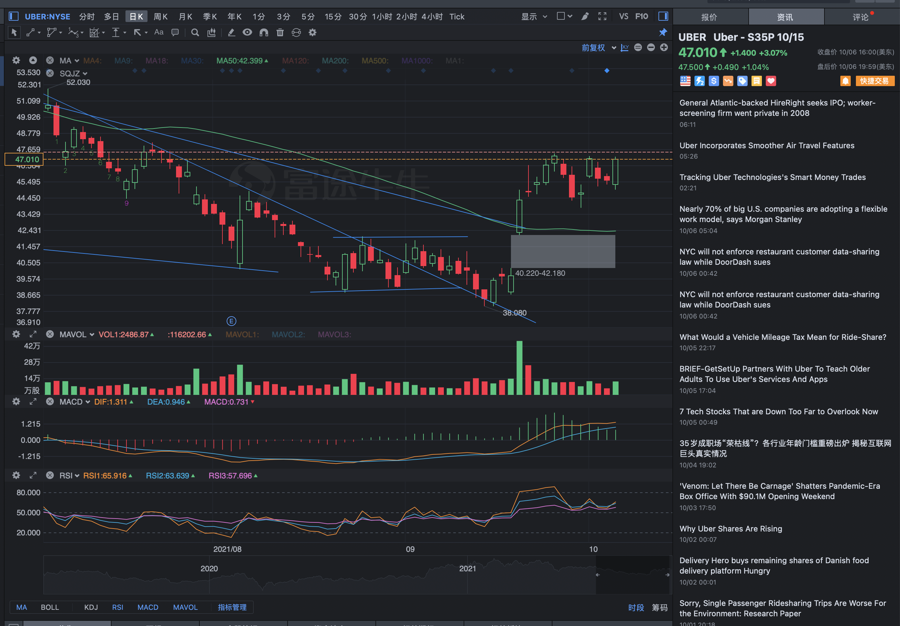

Stock Detail Page (1st Half)
search
News
K 线
Select indicator (e.g. MACD etc)
Only one indicator supported, can change

Slide 4
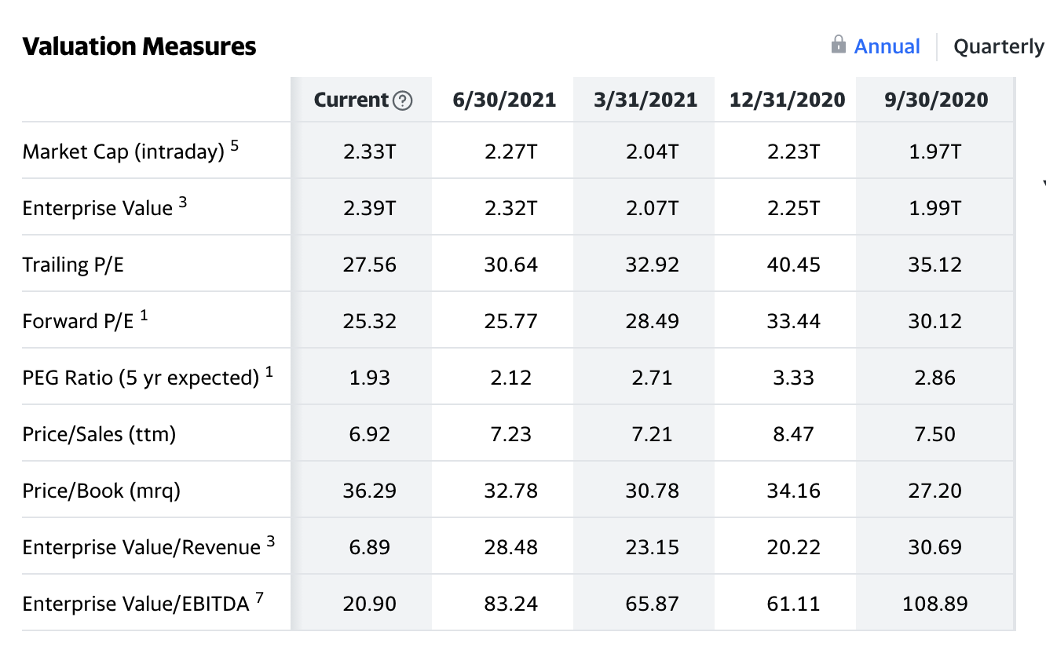
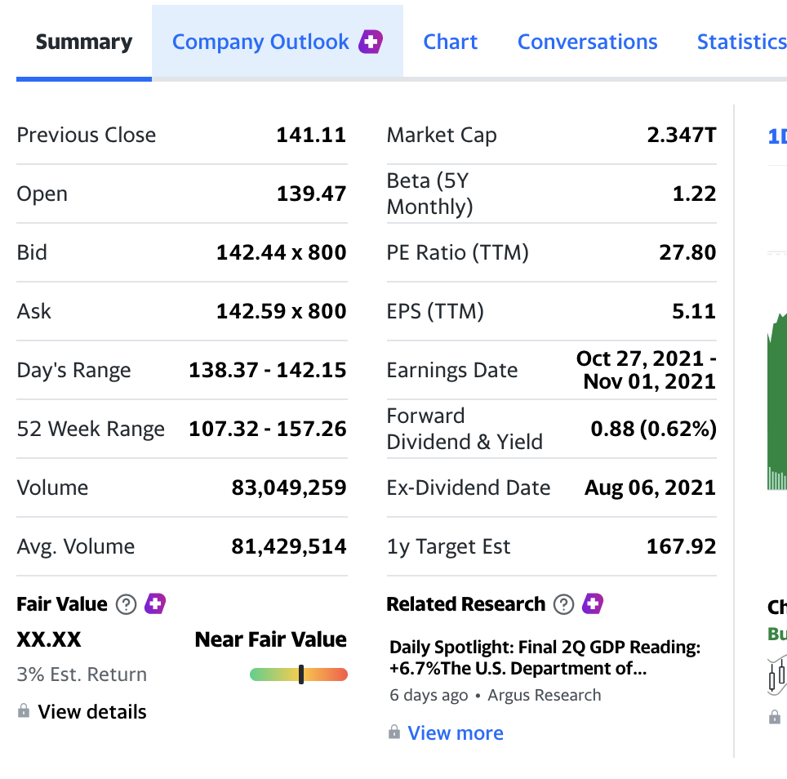
Stock Detail Page (2nd Half)
展开式 section1
展开式 section2
展开式 section3
这部分主要是similar stock 推荐

Slide 5
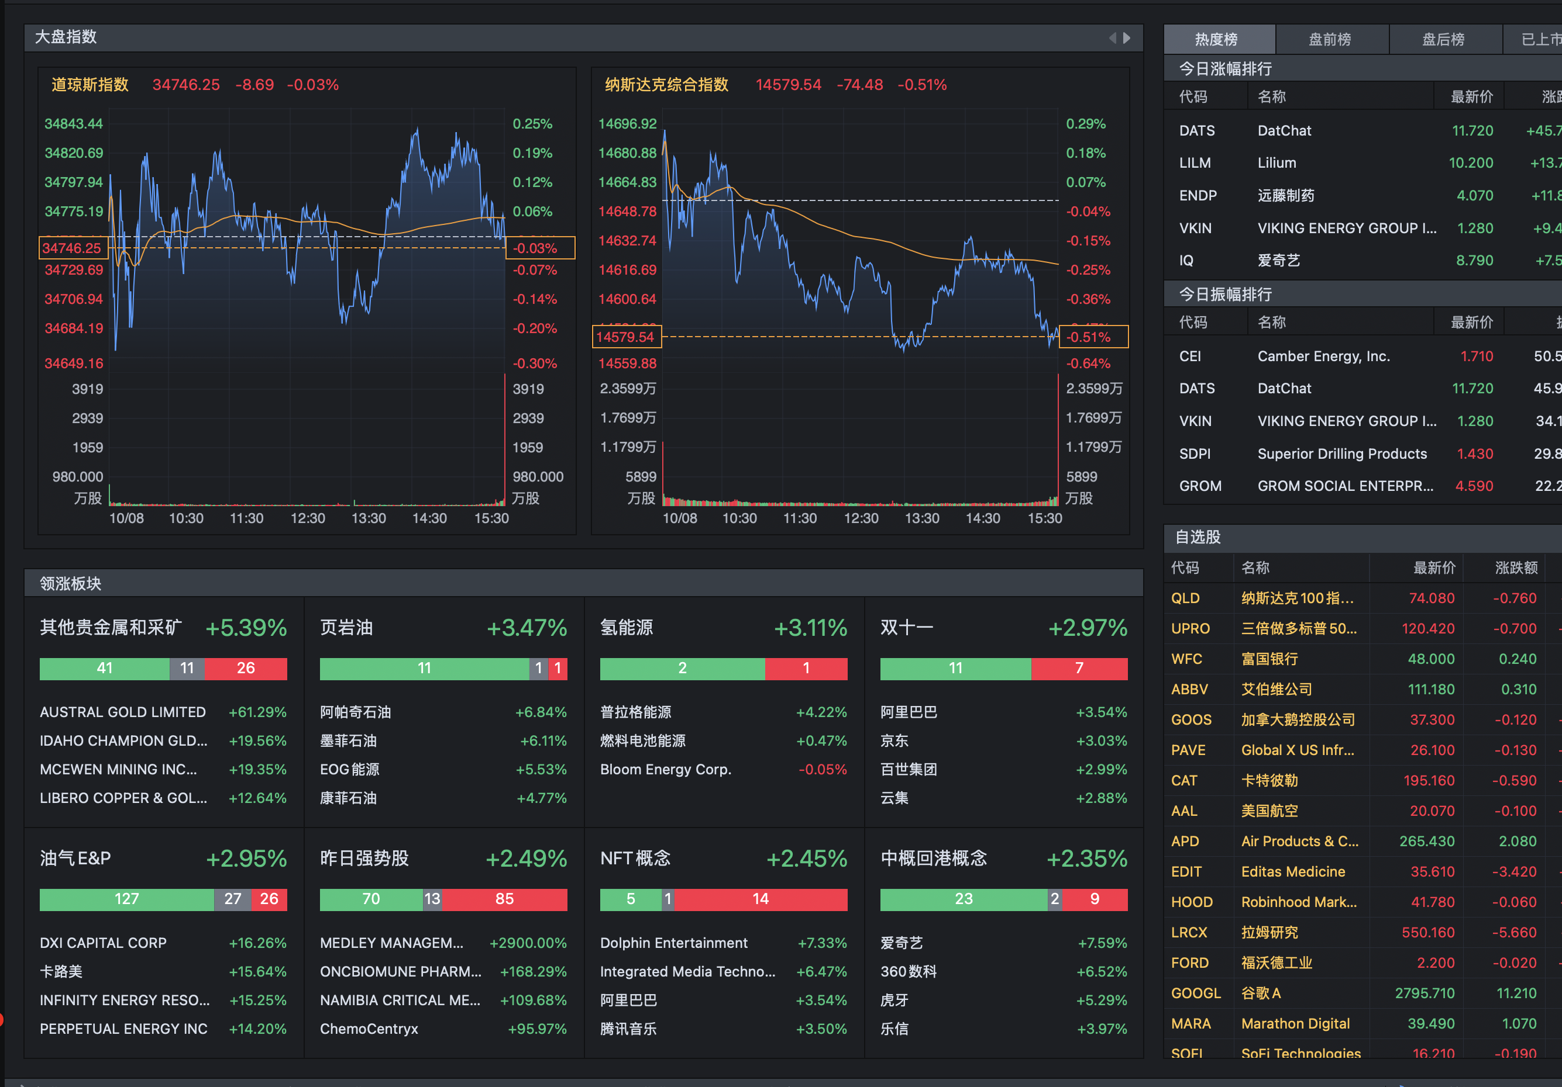
Sector

Slide 6
S&P component change
FAANG % in S&P
Other data

